Slide 1

7.3
Data Governance
& Compliance
Managing data the right way — and following the rules that govern it
Simple concepts, real-world examples, Nepal & global perspectives

Slide 2





What is Data Governance?
The framework of policies, processes, roles, and standards that keeps data trustworthy
Main Objectives
Data governance ensures data is:
Improve data quality
Accurate
Consistent
Secure
Available to authorized users
Used responsibly
Protect sensitive information
Define who can access data
Reduce errors and duplication
Example
A college keeps student records. Governance makes sure names, marks, and attendance are entered correctly, kept updated, and seen only by authorized staff.
Support better decisions
7.3 Data Governance and Compliance
2

Slide 3
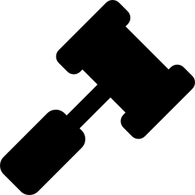
What is Compliance?
Following legal, regulatory, and organizational requirements for handling data
Organizations must comply with government laws, industry regulations, privacy policies, and internal company rules.
Examples of Compliance Requirements
Area | Example
Privacy | Protect personal information
Financial data | Maintain audit records
Health data | Keep patient information confidential
Digital transactions | Follow electronic transaction laws
7.3 Data Governance and Compliance
3

Slide 4
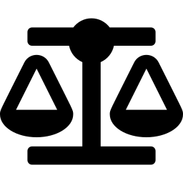
Governance & Compliance — How They Connect
Data Governance
Compliance
How we manage data —
policies, roles, and controls
Whether we follow the
required laws and rules
Governance provides the structure and controls — Compliance makes sure those controls satisfy laws and regulations.
7.3 Data Governance and Compliance
4

Slide 5

Key Components of Data Governance
Data Policies
Data Ownership
Quality Management
Access Control
Rules for collecting and using data
Defines who is responsible
Ensures correctness of data
Limits who can view data
Data Security
Lifecycle Management
Auditing
Protects against unauthorized access
Controls storage and deletion
Tracks data activities over time
7.3 Data Governance and Compliance
5

Slide 6


Why Compliance Matters
Compliance helps organizations stay safe, legal, and trusted
Avoid legal penalties
Protect customer privacy
Build trust
Reduce security risks
Maintain business reputation
Support audits
7.3 Data Governance and Compliance
6

Slide 7
Common Data Compliance Areas
Area | Requirement
Personal Data | Collect only necessary information
Consent | Obtain user permission
Data Retention | Keep data for the required period
Data Sharing | Share only with authorization
Breach Reporting | Report data leaks when required
7.3 Data Governance and Compliance
7

Slide 8

Data Governance & Compliance in Nepal
Electronic Transactions Act, 2063 (ETA)
The legal basis for electronic records, digital signatures, and cyber-related offenses
Data governance is still developing in Nepal
Banks, telecoms, and government agencies are leading adoption of security policies and access controls
Data protection practices are improving as digital banking, e-commerce, and online government services expand
Growing focus on privacy under the Constitution of Nepal (Right to Privacy)
7.3 Data Governance and Compliance
8

Slide 9
Nepal vs. Foreign Perspective
Aspect | Nepal | Foreign Countries
Main Laws | ETA 2063, Constitution (Right to Privacy) | GDPR, CCPA, HIPAA
Governance Maturity | Developing; banks & telecoms lead | Highly mature, widely implemented
Privacy Protection | Basic, growing focus | Strong rights, strict enforcement
User Rights | Limited explicit rights | Access, correct, delete, transfer data
Penalties | Generally lower | Very high fines (e.g. GDPR)
Public Awareness | Increasing but limited | Generally higher
7.3 Data Governance and Compliance
9

Slide 10
Practical Example: Banking System
Governance
Compliance
Customer data is entered in a standard format
Only authorized employees can view account details
Regular backups are taken
Customer privacy is protected
Transaction records are preserved for auditing
Electronic transaction laws are followed
7.3 Data Governance and Compliance
10

Slide 11
Exam-Oriented Summary
Data Governance and Compliance means managing data through policies, standards, and controls so it stays accurate, secure, and properly used — while also meeting legal and regulatory requirements.
Data Governance
Compliance
How data should be managed
Following laws and regulations
Goal: Safe, accurate, legal, and trustworthy use of data
7.3 Data Governance and Compliance
11

